Slide 1
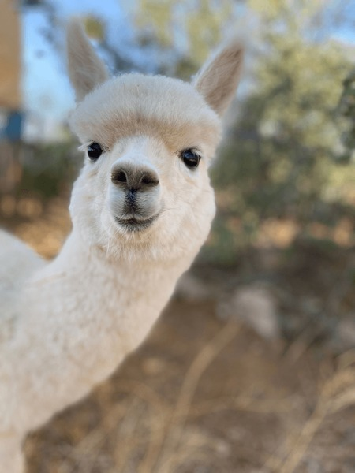
ollama demo
Good alternative
for OpenAI / Gemini

Slide 2
Setup
Download and install local
AI model pulling on local – pros / cons
AI model on cloud (gpt-oss:120b-cloud) – pros / cons
Cloud model free credits
Sign in on web / local

Slide 3
Simple RAG demo
Retrieval-Augmented Generation
PDF / text file interaction (QnA)
Retrieve - Read PDF file / Find useful info
Augment – Chunking / Add info the knowledge of AI
Generate – Answer question / Generate better response
Happy cases
Unhappy cases

Slide 4
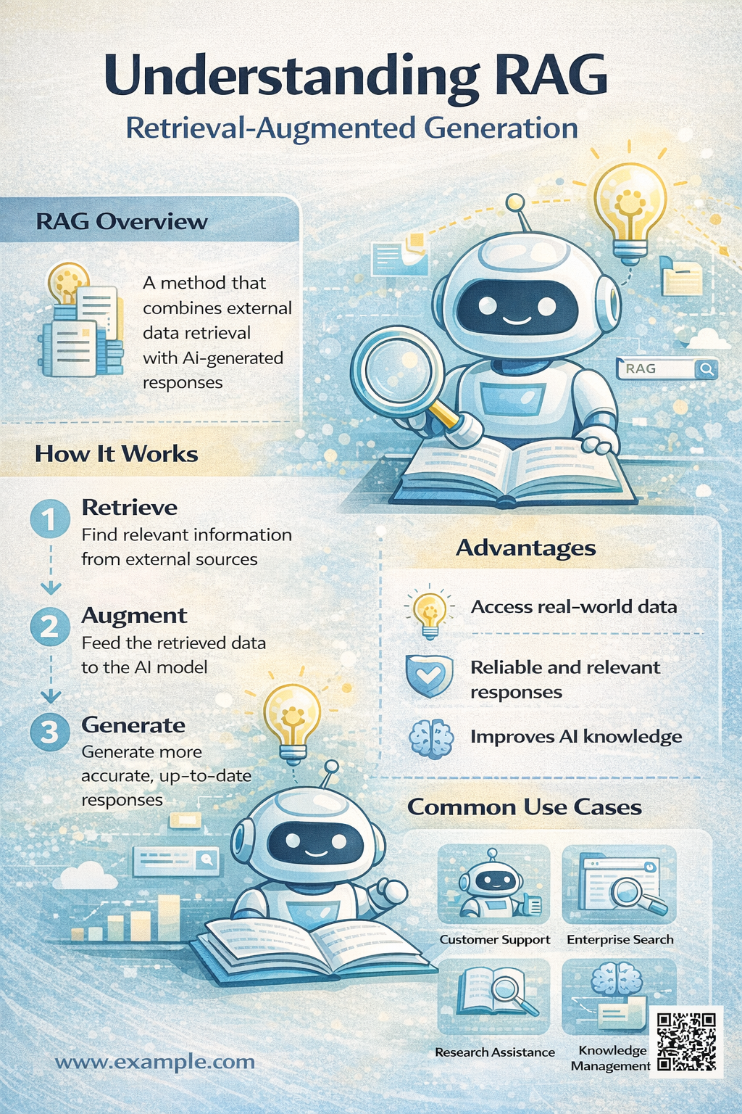

Slide 5
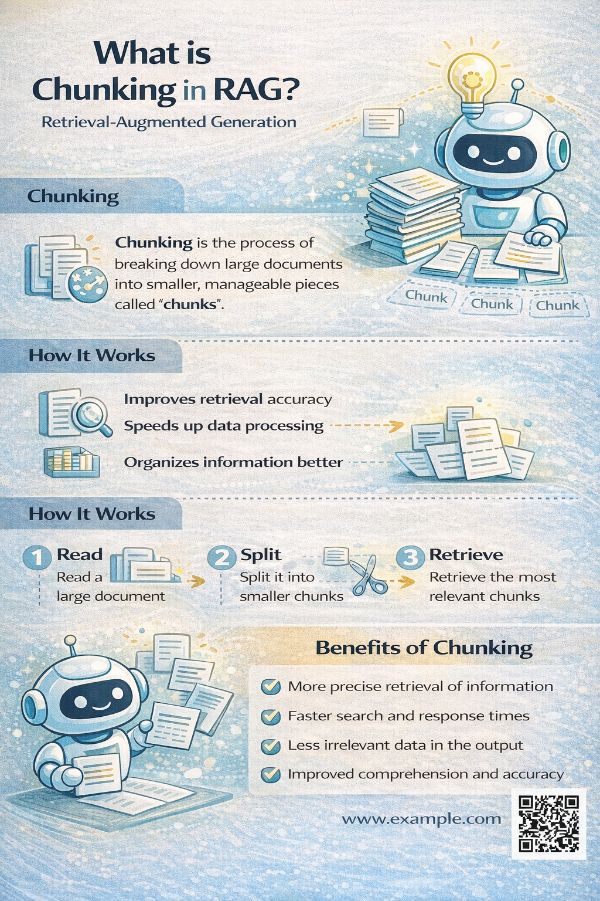

Slide 6
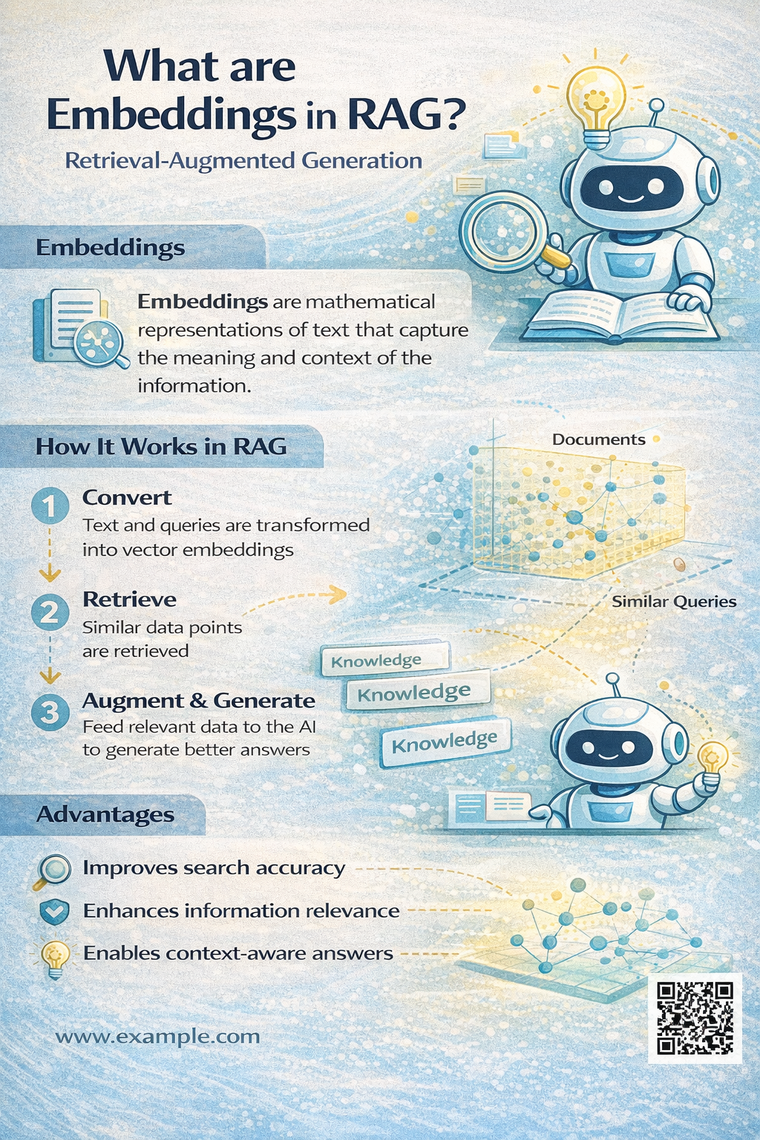

Slide 7
Simple RAG demo
Case study - AWS EC2 instance types help pdf
Read pdf from AWS website
Get 15 question and answers from Gemini from comparison
Ask the same questions to ollama (CPU performance check)
Analyze ollama answers
Compare both AI model answers

Slide 8
Simple RAG demo
Case study - AWS EC2 instance types help pdf
Unhappy cases

